Slide 1

Institute for Stochastics and Applications Mathematical modeling and simulation of cellular systems
Leveraging Genetic Algorithms to Predict Initial Conditions for Optimal Spatial Patterns in 2D Reaction-Diffusion Systems
Loghman Samani
09.07.2024
Notes:
Welcome everyone to my presentation.
Today, I will talk about our project titled “Leveraging Genetic Algorithms to Predict Initial Conditions for Optimal Spatial Patterns in 2D Reaction-Diffusion Systems.”
This project is a collaborative effort by our team to explore and optimize patterns in complex systems using genetic algorithms.

Slide 2
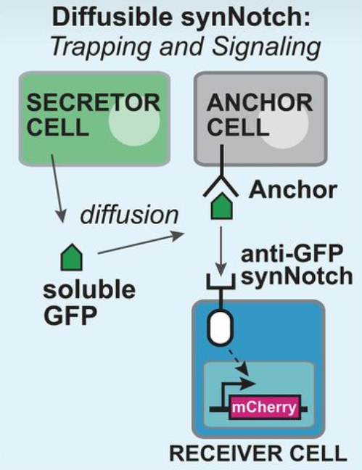
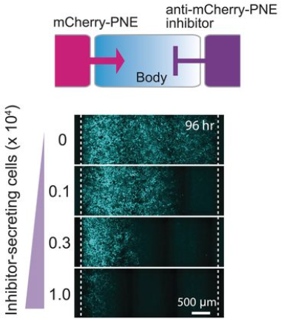
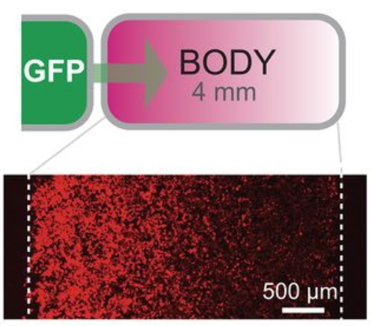
Synthetic morphogen systems
Synthetic Notch system
S. Toda et al., 2020
Arbitrary proteins engineered into synthetic morphogens.
Formation of gradients and directing cell patterning.
Applications in advanced tissue engineering.
“Engineering synthetic morphogen systems that can program multicellular patterning”
Diffusible synNotch system. (S. Toda et al., 2020)
Notes:
Initially, we were inspired by an article written by Toda and his colleages in 2020. They used the SynNotch system to see if molecules like GFP or mCherry could be turned into synthetic morphogens.
Looking at the figure on the top right, we see a diffusible SynNotch system. Here, secretor cells release GFP molecules, which are then sensed and received by other cells, changing their fate. On the bottom right, we see how the gradient in tissue can be modified by trapping morphogens (GFP or mCherry) with anchor molecules on the surface of specific cells, as well as by GFP inhibitors (mCherry-inhibitors) released from other specific cells in the tissue.

Slide 3
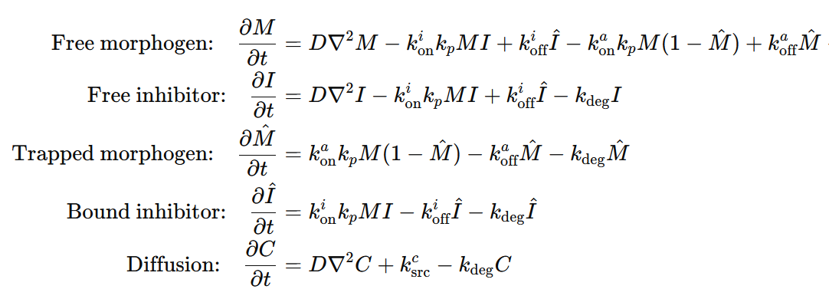
Computational model
Proteins Present in the System
Morphogen
Inhibitor
Anchor
Mathematical Equations (S. Toda et al., 2020)
Diffusion: Represents the spread of proteins
Inhibitor binding: Interaction between morphogen and inhibitor
Anchor binding: Interaction between morphogen and anchor
Degradation: Rate at which proteins degrade over time
Notes:
Here we see the mathematical equations from Toda's paper.
This simple system includes a morphogen, its inhibitor, and an anchor that can trap the morphogen.
The ODEs describe each component: the free and trapped morphogen, the free and bound inhibitor. Key terms like k_on​, k_off​, and k_degradation help us understand how these proteins interact and spread. The last equation shows how diffusion applies to both the morphogen and its inhibitor.

Slide 4
Protein Secretion Patterns
Morphogen Secretion
Inhibitor Secretion
Cells capable of producing morphogen
Indicated by green cells
Cells capable of producing inhibitor
Indicated by red cells
Notes:
In our work, we started by defining a 2D compartment, similar to a tissue with a single cell layer.
We then designated specific cells as morphogen producers and others as inhibitor producers.
On the right, we see a schematic representation of this setup. The top illustration shows morphogen-producing cells in green, located in the first column of the compartment. The bottom one shows inhibitor-producing cells in red, located in the last column.

Slide 5
Diffusion Patterns
Analysis of protein diffusion in a 2D tissue compartment.
Examining three distinct diffusion patterns based on cell location.
Corner Cells
Edge Cells
Central Cells
Cells located at the four corners of the compartment.
Cells situated along the edges of the compartment.
Cells positioned in the middle, away from edges and corners.
Notes:
Next, we developed 2D-diffusion patterns. On the right, you can see three main diffusion patterns in the system.
The first one defines a diffution pattern for Corner Cells: These cells are in the four corners of the compartment and communicate with two neighboring cells.
The second one defines a pattern for Edge Cells: These cells are along the edges of the compartment and communicate with three neighboring cells.
And the last one is about Central Cells: These cells are in the middle, away from edges and corners, and communicate with four neighboring cells.
These diffusion patterns ensure that the diffusible proteins, such as morphogen and inhibitor, spread evenly throughout the system.

Slide 6
Simulation Results
Using ODEs to Simulate the System
Compartment Size: 100 x 100
GFP Production: First 10 columns on the left
GFP Inhibitor Production: First 10 columns on the right
Anchor Production: None
Free GFP Inhibitor-GFP Free Inhibitor
Notes:
Here, we are going to look at some simulation results using the system I explained in the previous slides. In this simulation, we have a morphogen (GFP), its inhibitor, and anchor cells that can trap the morphogen. However, in this specific example, there are no anchor-producing cells, so no morphogen will be trapped.
We defined the compartment as a 2D matrix with a size of 100 by 100 cells. Cells in the first 10 columns on the matrix produce GFP, while cells in the last 10 columns of the matrix produce the inhibitor.
In the next slide, we will watch videos, each with three sub-videos, same as the illustration in this slide. The left sub-video shows the compartment with free GFP, the right sub-video shows the free inhibitor, and the middle sub-video shows the inhibited GFP (GFP bound to the inhibitor).
We expect to see the GFP and inhibitor spread out from their respective regions and meet in the middle of the compartment, which will be shown in the middle sub-video.

Slide 7
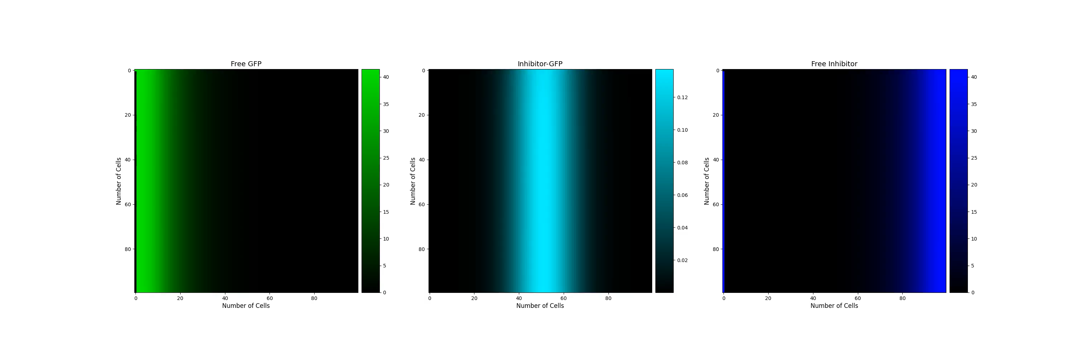
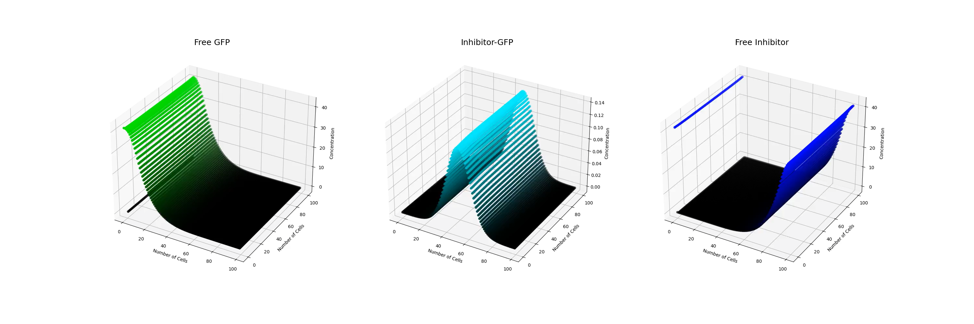
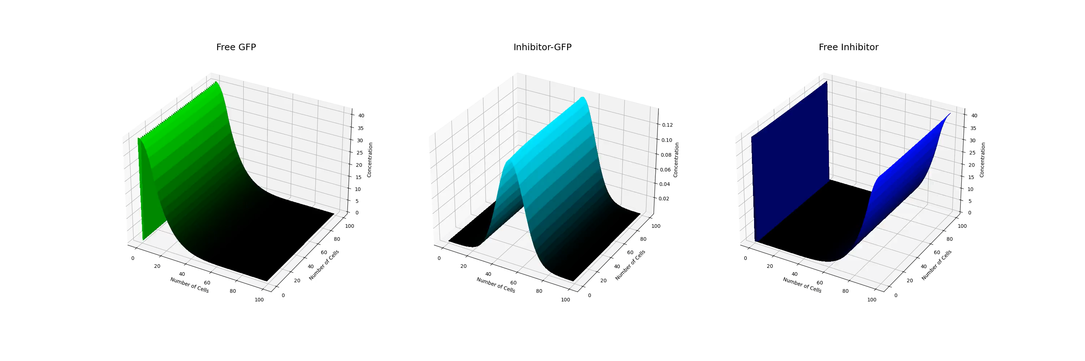
Number of iterations = 2500
Number of frames = 500
Initial morphogen and inhibitor concentration in each cell = 5
Notes:
Here in this slide, we see the videos, all generated from the same simulation results.
The first video shows heatmaps of the system, where pixel intensity represents cell protein concentration.
The second video is scatter plots, with the z-axis showing protein concentration.
And in the last row of videos illustrates the system as surface plots, with the z-axis again representing protein concentration.

Slide 8
Genetic Algorithms for Pattern Formation
R. Mousavi and D. Lobo, 2024
Using genetic algorithms to optimize initial protein concentrations for desired spatial patterns.
Develop a genetic algorithm to design and optimize protein concentrations for spatial pattern formation in our system.
“Automatic design of gene regulatory mechanisms for spatial pattern formation”
Notes:
After developing the simulation system described in the previous slides, we decided to advance our work by incorporating an optimization algorithm. We drew inspiration from Mousavi and Lobo's work, published this year in Nature. They developed an evolutionary algorithm that automatically designs synthetic gene regulatory mechanisms (GRMs) for complex spatial patterns.
In our work, we designed a Genetic Algorithm to predict the initial concentrations of components in our system based on the desired target protein distribution after simulation.

Slide 9
Genetic Algorithms (GAs)
Introduction
Population Initialization
mimic the natural selection process to find optimal solutions
Pioneered by John Holland’s work(1970s)
represent potential solutions as chromosomes
evolve populations towards better solutions by applying genetic operators like recombination and mutation
Simulation
Fitness Computation
Selection of Survivors
"Adaptation in Natural and Artificial Systems"
A. Lambora et al., 2019
Recombination (Crossover)
Mutation
Update Population
Return the Best Result/s
Notes:
The simple algorithm we developed is a Genetic Algorithm, inspired by biological evolution and natural selection. These algorithms use concepts like crossover, mutation, and selection to optimize solutions, which are represented as chromosomes. John Holland pioneered this field in the 1970s, with his notable book "Adaptation in Natural and Artificial Systems" discussing genetic algorithms.
On the right side, we see the structure of our designated algorithm. In the next slides, I will explain each concept in this system step by step.

Slide 10
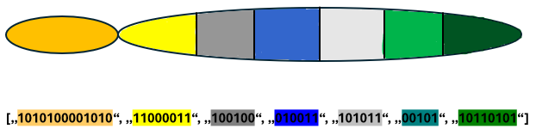
Genetic Algorithms
Population Initialization
Each species matrix is created as a random binary string.
Each chromosome is a list of binary strings.
Each string represents an initial species or parameter matrix.
The population is a nested list, with each value being a chromosome.
Parameters sp 1 sp 2 sp 3 sp 4 sp 5 sp 6
Notes:
The first step in our algorithm is population initialization. This involves creating a collection of potential solutions to the problem, known as the population. Each solution, or chromosome in the population, is a list of randomly generated binary strings. These strings represent the initial concentrations of species in the system. We also have a sub-chromosome that gathers all parameters into a single binary string. So the population is a nested list containing multiple chromosomes, each representing a different potential solution.

Slide 11
Genetic Algorithms
Simulation
Convert binary chromosomes into real number matrices.
Each converted chromosome is a list of species and parameter matrices.
Simulate the system using each chromosome.
Convert simulation results back to binary.
Store results in a list
Notes:
After initializing the population, the next step in our algorithm is to simulate the system with each chromosome in the population. First of all each chromosome is converted from binary strings into real number matrices, representing species and parameter values.
These matrices are then used to simulate the system.
The simulation results are stored in a list, and for further processing, these results are converted back into binary representation.

Slide 12
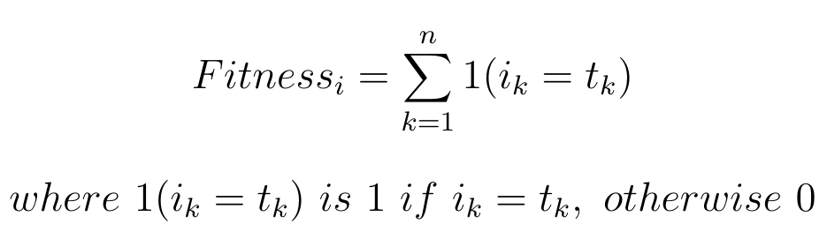
Genetic Algorithms
Fitness Computation
Evaluate how close each individual is to the target solution
Compare each simulation result binary string to the target binary string
Result is a list of fitness values for the population
Notes:
Next, the algorithm evaluates the simulation results. Each simulation result is compared bit by bit to the target solution. This way, the algorithm calculate a fitness score for each chromosome. The goal of the algorithm is to maximize the fitness of each chromosome, bringing it closer to the target solution.

Slide 13
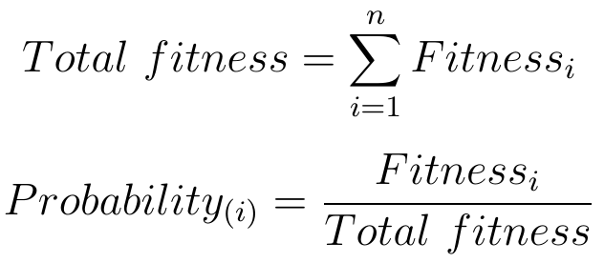
Genetic Algorithms
Selection of Survivors
Fitness Proportionate Selection (Roulette Wheel Selection)
Randomly select individuals based on their probabilities
Select parents for the next generation based on fitness scores
Result is a list of selected parents for the next generation
Notes:
Next, it selects the best chromosomes in the population based on their fitness. Here we use the Roulette Wheel Selection method, which gives chromosomes with higher fitness a better chance of being selected. This step ensures that the best solutions are more likely to be represented in the next generation. it selects N (population size) chromosomes to form the pool for the next generation.

Slide 14
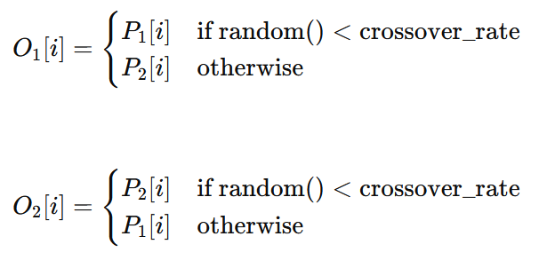
Genetic Algorithms
Recombination (Crossover)
Genetic recombination of parents to generate offspring
Offspring O1​ and O2​ inherit traits from both parents
crossover_rate: Probability of crossover.
i: Index of sub-chromosome in chromosomes
Notes:
In the next block of the algorithm, the selected pool of chromosomes, now referred to as parents, undergoes the crossover process. In this step, the algorithm randomly pairs two parents from the population pool and exchanges information between their corresponding sub-chromosomes. This exchanges are based on the crossover probabilities. The result is a new population pool where each chromosome is now an offspring, inheriting traits from both parents.

Slide 15
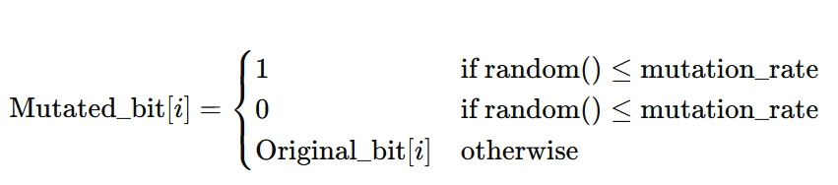
Genetic Algorithms
Mutation
Introduce random changes to the chromosome
Enhance genetic diversity for better exploration
prevent local minima
mutation_rates: Probability of mutating each bit
Notes:
In the next part of the algorithm, each offspring chromosome undergoes mutation. In this process, each bit in the sub-chromosomes of each chromosome has a chance to be flipped, meaning a 0 becomes a 1 and a 1 becomes a 0. This happens with a specific mutation rate defined for each sub-chromosome. This step introduces random changes to enhance genetic diversity and prevent the algorithm from getting stuck in local minima.

Slide 16
Genetic Algorithms
Update the population
Stop: If desired or optimal fitness achieved
Update: Otherwise, update population and repeat
Iterative Process: Continues until convergence
Notes:
After mutation, each offspring is sent to the next generation, creating a new population pool. This iterative process continues until one or more chromosomes in the population achieve the desired fitness level or a predefined fitness threshold is reached. When this happens, the algorithm has converged, and the best solution, corresponding to the highest fitness, is returned as the output of the algorithm.

Slide 17
Results of the genetic algorithm

Slide 18
Challenges and Solutions
Computational Intensity
Model Specificity
Non-Uniform Gradient in Diffusion
GA Inefficiency
Solution: Parallel computation, Numba (@jit), Julia
Solution: Generalize with modular blocks
Solution: Optimize diffusion calculation method
Solutions:
Improve fitness function
Alternative chromosome representation
Better selection methods
Notes:
challenge: Computational intensity in both simulation and GAs optimization Solution: parallel compotation (vectorization the code), using libraries like numba to run the code just in time (@jit) or programming languages like julia which are more appropriate for numerical computation than python (which we corrently use) challenge: specificity of the models (for each model at the moment we should write a specific code) Solution: generalize the models (e.g. using building blocks for each concept and choose some of them based on your needs) Challenge: The specie diffusion in our simulated models does not have a unify gradient in a row (which should be the case in our case becase we use ode and same initial concentration for the same specie in each cell) Solution: the problem is maybe because we use loop for calculating diffusion and it means cell after cell it will be calculated which may cause ununify gradient. Challenge: Efficency of GAs (our corrent model does not converge 100 percently) reasons: 1) fitness function may not be the best one(it tries to maximize the fitness using bit with bit comparision), 2) binary representation of the chromosomes may not be the best percidure(ist efficient but may not be the best choise) becase each number in a matrix is represented with 8 or more bits, so the chromosome length is 8 times bigger, 3) selection functions which we use may not be the best choices (Roulette-Wheel & tournament) Solution: we will search for new ways and functionalities and examine them to improve our models.
Lost of information during conversion from real number to binary and vise versa

Slide 19
Outlook
Improve Current Models
Simulate in Higher Dimensions
Add Growth Rate
Enhance Information Sharing
Increase Diffusion Edges
Incorporate Stochastic Methods
Advance GA Algorithm
Combine Optimization Algorithms
Create a Simulation Library
Notes:
Improve Current Models
Solve previously mentioned challenges
Simulate in Higher Dimensions
Expand from 2D to 3D simulations
Add Growth Rate
Introduce cell division to mimic biological systems
Enhance Information Sharing
Increase the number of neighboring cells sharing information
Increase Diffusion Edges
Allow diffusion in more directions beyond the current four edges
Incorporate Stochastic Methods
Use stochastic methods alongside ODEs for simulations
Create a Simulation Library
Develop a Python library for 1D, 2D, and 3D simulations
Advance GA Algorithm
Allow GA to add new species through mutation
Use various mutation types like insertion
Combine Optimization Algorithms
Integrate different optimization methods to enhance GA performance
Improving current models (it means solve the challenges which i mentioned in prevoius slide, project challenges and solutions) Simulating the system in higher dimensions (our current simulation models are implemented in 2D, which we will try 3D also) Adding growth rate to the system (it means till now each compartment wich we choose to simulate our models has a fixed number of cells, which we will add a growth rate to bring the system a step forward to more look like a biological system in which cells divide and the overall cell number is increased through time) In our models each cell can share infos with just the forst cell in each edge in it‘s neighrorhood (in some cases we add the option to share infos with cells) we may increase the number of cells which share infos with a cell), the frst cell is directly connected and the second one indirectly through the second one and so on. increase the diffusion edges (currently in our models each cell is connected and shares information with just four cells (each cell is a square so there is four edges and in each edge just one neighbour cell)), for example diffusion in infinite direction will be perfect Using also stochastic methods to simulate the system (currently we use ODEs to simulate the systems) Collect all implementation and create a library (python library) for simulating in 1, 2 and 3D Develope our GA algorithm, so that it will be able to add new species (to add non-linearity to it‘s predictions) ,throgh mutation process, to the models, currently our model is a model with the fix number of species and uses only point mutation(bit mutation) we can use other sort of mutations like insertion (insert a new specie) to our model. Combining/using different optimization algorithms to our GA model/to optimize our models to improve it‘s performance, currently we have not decided to use which algorithms, but we will consider this idea in our project.

Slide 20
Thank you for your time and attention

Slide 21
hm1.mp4
infos = { "compartment length": 100, "compartment width": 100, "initial cell number": 5, "start": 1, "stop": 50, "dt": 0.02, "save step interval": 5, "k_fm_sec": 0.5, "k_fi_sec": 0.5, "k_am_on": 0.04, "k_am_off": 2e-6, "k_im_on": 0.2, "k_im_off": 2e-4, "k_fm_deg": 0.02, "k_fi_deg": 0.02, "k_im_deg": 0.02, "k_am_deg": 0.02, "k_m_diff": 4, "k_i_diff": 4, "k_im_diff": 3 }
Number of iterations = 2500
Number of frames = 500
Initial cell number: initial concentration of morphogen or inhibitor in capable cells. (initial cell number/ ratio: initial concntration of anchor in capable cells(5))

Slide 22
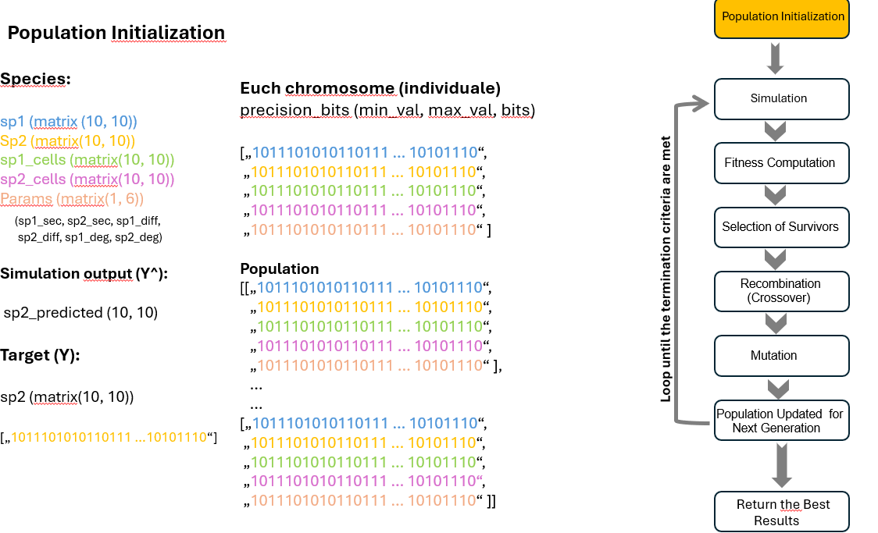

Slide 23
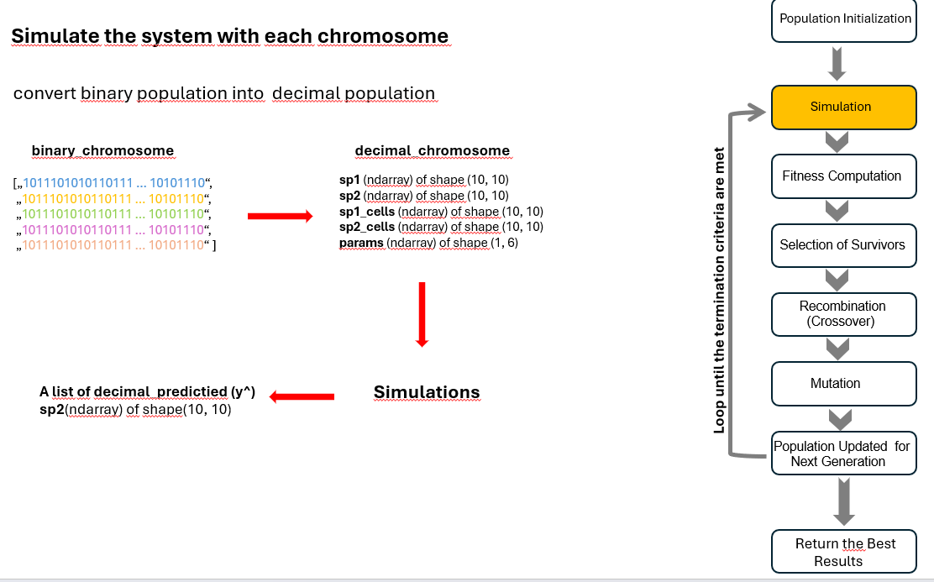

Slide 24
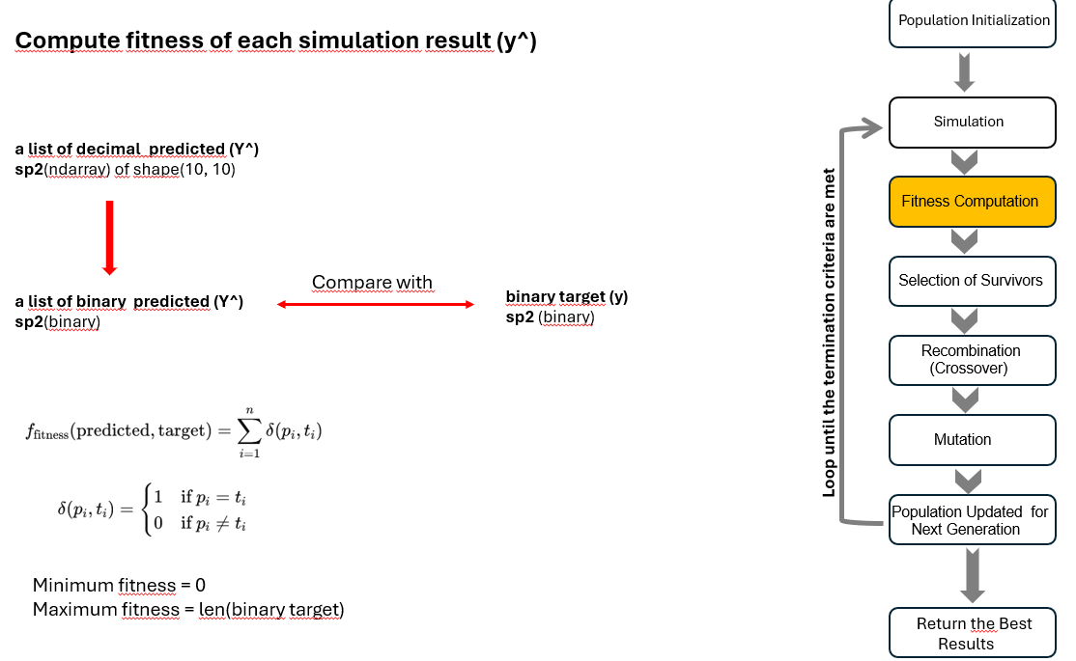

Slide 25
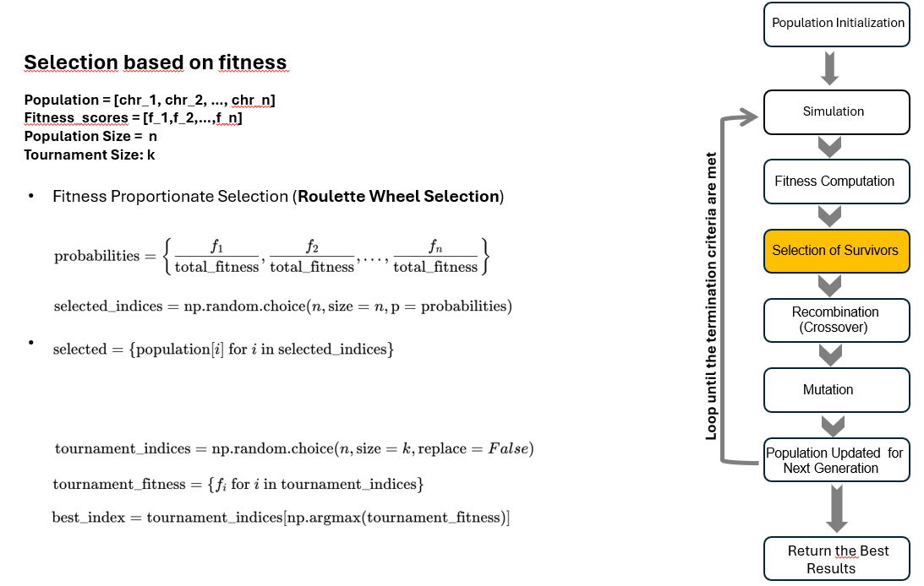

Slide 26
